Slide 1
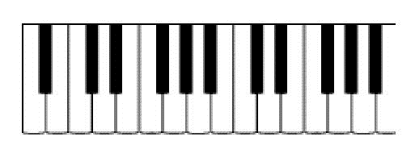
Pentatonic and blues scales
Tutorial on easy methods to learn these scales
Images in the slides are creative commons
This resource is © to Tabor Music 2020.
This resource is welcomed to be copied and distributed with acknowledgment to Tabor Music
http://music.tabor.edu.au

Slide 2
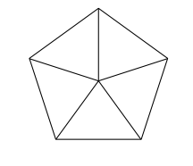
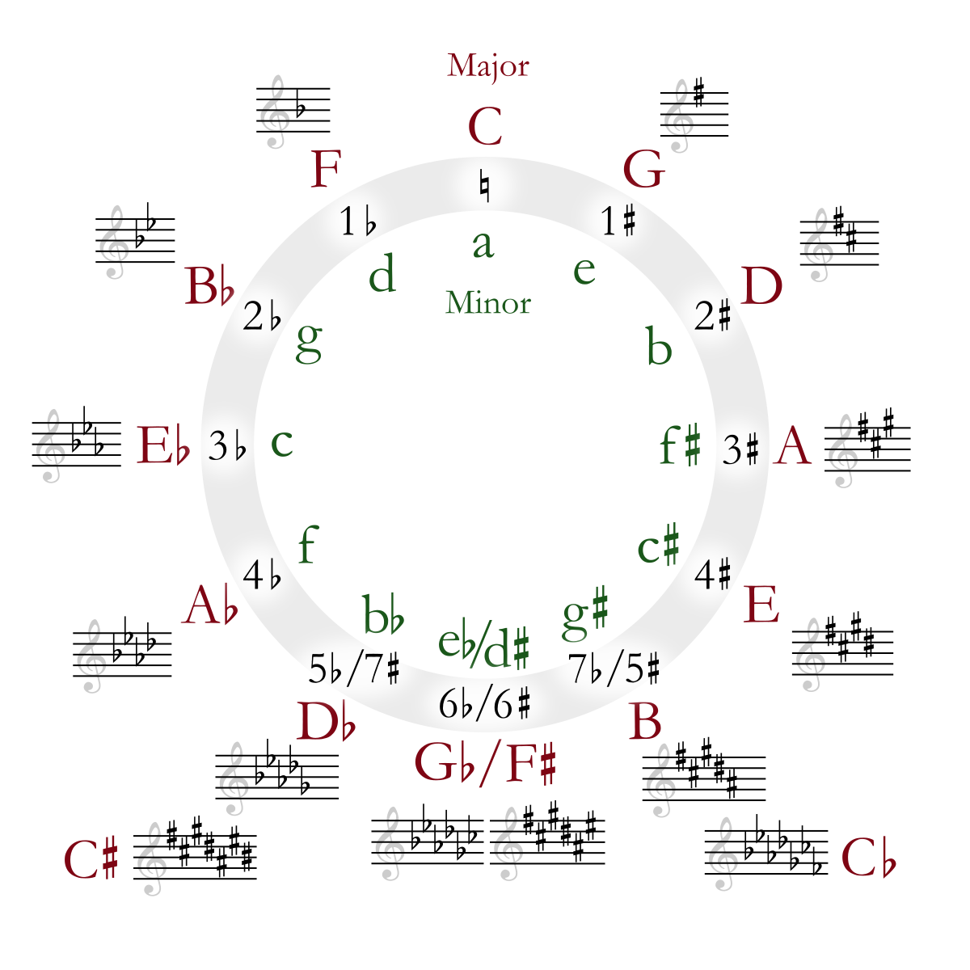
5 note scale
Pentatonic scales
Know your keys
Pentatonic scales are a five note scale which have existed since the early conception of music. Often heard in folk songs, pentatonic scales are also heard nowadays in jazz, blues, country, rock and traditional music.
There are two types: major pentatonic and minor pentatonic

Slide 3
Different Methods
Please note, there are lots of different methods and approaches to working out pentatonic and blues scales.
This powerpoint shows one method.

Slide 4
The wonders of the pentatonic scale
Here is just one example of the Pentatonic in action!
Youtube: Bobby McFerrin – Pentatonic Scale

Slide 5
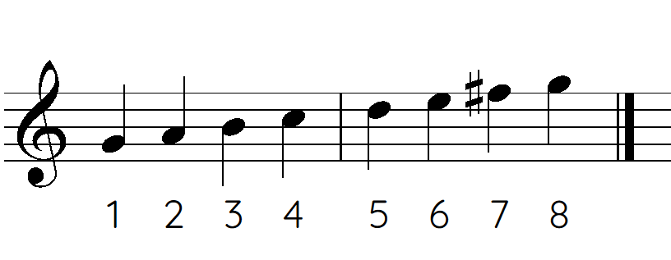
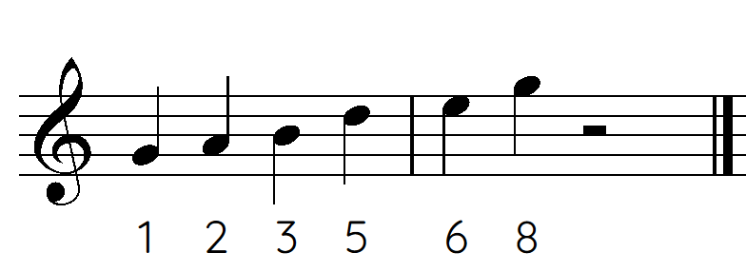
MAJOR Pentatonic Scale
Remember 8 and 1 are the same note
(just an octave apart)
These numbers are called scale degrees
Step 1: Write the major scale
Step 2: remove the 4th and 7th notes
Example: G Major Scale
Step 1: G A B C D E F# G
1 2 3 4 5 6 7 8
STEP 2: G A B D E G = G Major pentatonic
1 2 3 5 6 8
More examples
Listen to the
G Major Pentatonic

Slide 6
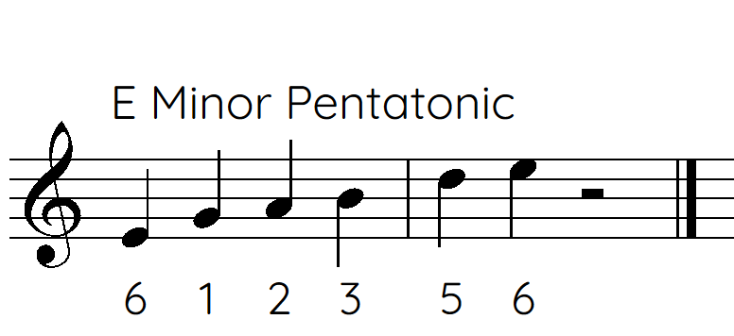
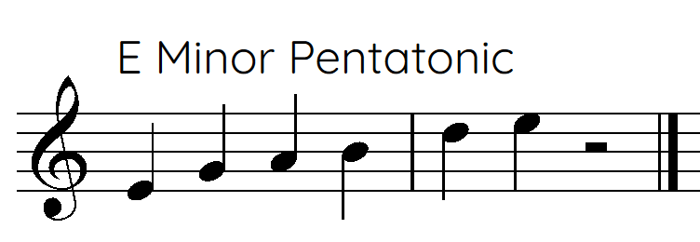
MINOR Pentatonic Scale
Relative = the keys share the same key signature.
IE) G Major and E minor both have an F# in their key signature
Step 1: Write the major relative pentatonic
Step 2: Rearrange to start on the minor
Example: E Minor pentatonic
Step 1: Write G Major pentatonic
G A B D E G
STEP 2: re-arrange starting on E
E G A b D E
Notice how G major pentatonic and E minor pentatonic have the same notes
Listen to the
E Minor Pentatonic
Other examples

Slide 7
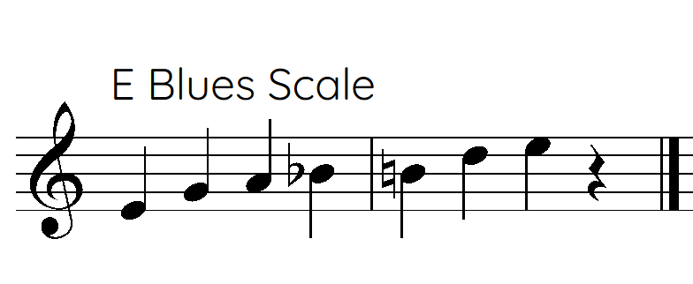
Blues scale
Sharp 4 means raise the fourth. Flat 5 means lower the 5^{th.}
Because sometimes it will already been sharp/flat so you would need to use accidentals such as naturals or double sharps/flats.
Enharmonic = two different ways of spelling notes
such as
A sharp and B flat
Step 1: Write the Minor Pentatonic
Step 2: Add a Sharp 4th or Flat 5th
Example: E Blues
Step 1: Write E minor pentatonic
E G A b D E
STEP 2: Add a sharp 4 or flat 5
(count the number of notes that are there, not the scale degrees)
Notice how the blues scale only has ONE NOTE different to the E Minor Pentatonic
OR
Listen to the
E Blues Scale
sharp4
flat5

Slide 8
For more resources and information
http://music.tabor.edu.au
Email: music@tabor.edu.au

